Slide 1
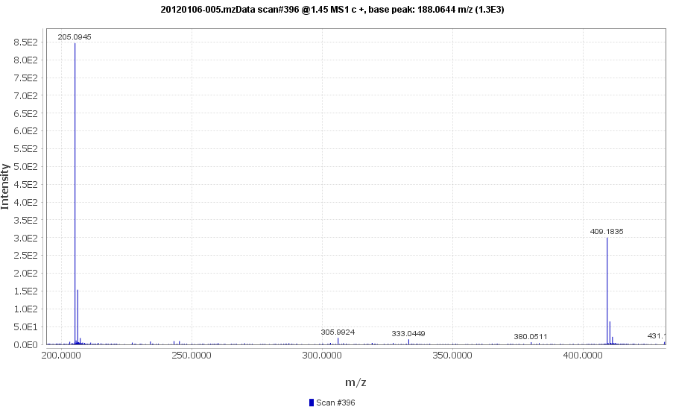
Exercise 3

Slide 2
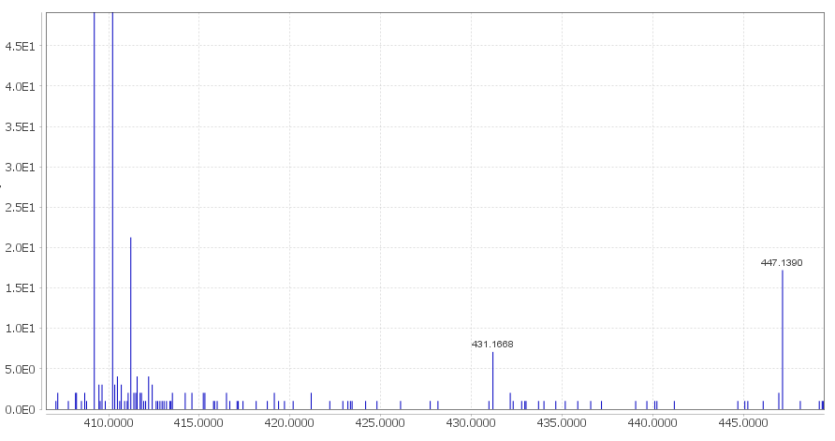
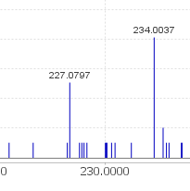
Exercise 3
[2M+K⁺]⁺
[2M+Na⁺]⁺
[M+Na⁺]⁺

Slide 3
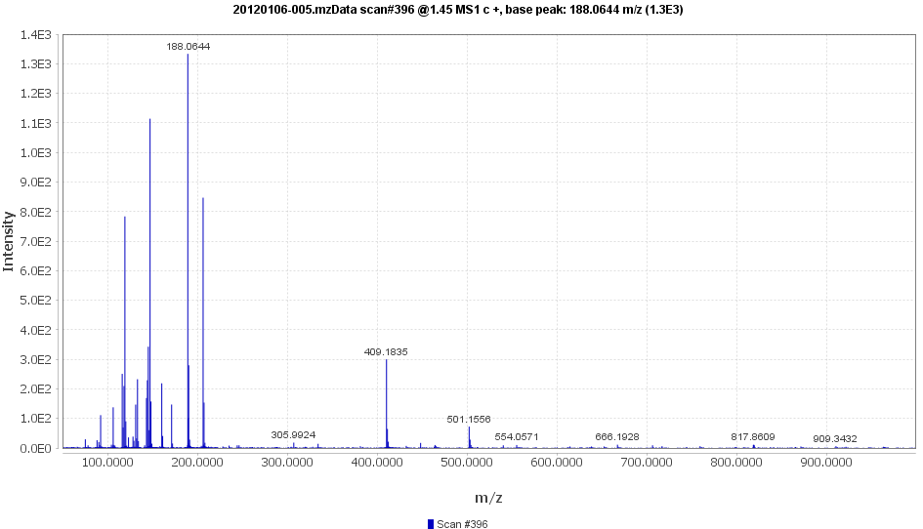
Exercise 3
?
?
[3M+H⁺]⁺ is not there?
[2M+H⁺]⁺ or [4M+H⁺]⁺
817.3937

Slide 4
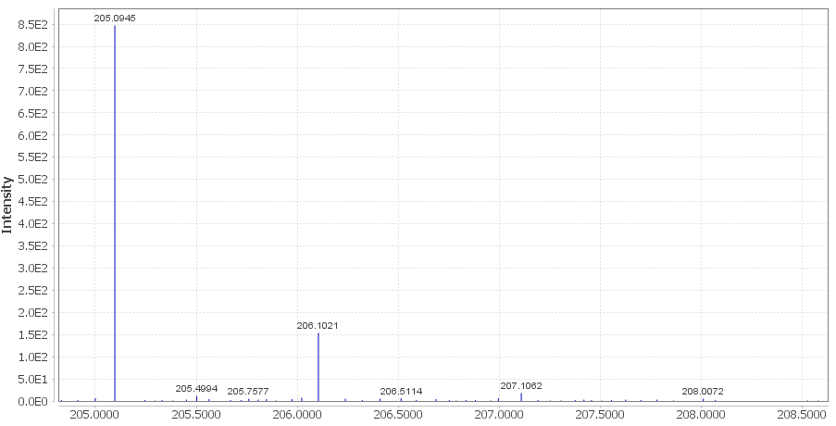
Exercise 3

Slide 5
Exercise 3
Formula | Nitrogen rule | DBE | Calc. m/z | ppm | Ion | Adduct formula
C6H12N4O4 | Valid | 3 | 205.0931 | -6.71 | [M+H]+ | C6H13N4O4+
C5H13N6OP | Valid | 3 | 205.0961 | 7.95 | [M+H]+ | C5H14N6OP+
C8H17N2PS | Valid | 2 | 205.0923 | -10.9 | [M+H]+ | C8H18N2PS+
C11H12N2O2 | Valid | 7 | 205.0972 | 13 | [M+H]+ | C11H13N2O2+
C9H18OP2 | Valid | 2 | 205.0906 | -19.3 | [M+H]+ | C9H19OP2+
C9H17O3P | Valid | 2 | 205.0988 | 21.1 | [M+H]+ | C9H18O3P+
C9H16O3S | Valid | 2 | 205.0893 | -25.5 | [M+H]+ | C9H17O3S+
C11H13N2P | Valid | 7 | 205.0889 | -27.4 | [M+H]+ | C11H14N2P+
C8H16N2O2S | Valid | 2 | 205.1005 | 29.5 | [M+H]+ | C8H17N2O2S+
Few C compared to N + O
Unlikely to see N2PS

